Slide 1

Tighten your NuGet packages
Notes:
Before Demo starts make sure you‘ve logged in to NuGet.org and have the main.yml open on Github.org for showing the pipeline.
Verify the client is not checked out, clean the solution and make sure the bin and obj folders are deleted from the web api projects. We don‘t want the fun start immediatly.
Disable live debuging from slide 8!!!!
Open explorer to C:\VisugXL\TightenYourNugetPackages.Client
And a powershell to C:\VisugXL\TightenYourNugetPackages.Client
Start C:\Tools\SnapTimer

Slide 2

About me
Pieter Samyn
Technology lead
ZF, transics

Slide 3

My Digital Diary
Notes:
For this session I created a small demo project called My Digital Diary.
It exists of two seperate solutions, the first solution is about the creation of the NuGet package itself.
The second solution is about using a NuGet package in your project.
The name was not a random project choice, but it’s because if you keep Diary it is something personal. And you don’t want anyone else peeking in it without your permission.

Slide 4

Prerequisites
Mandatory
SDKs
.NET SDK 6.0.300 <=
NuGet 6.2 <=
Optional
Visual studio extension
Command task runner
Tools
NuGet Package Explorer
Notes:
For this solution and the eventual outcome to work properly the .NET SKD 6.0.300 or newer and .NuGet 6.2 are the absolute minimum. With .NET8 just being released this shouldn’t be an issue I guess.
Optionaly you could use NuGet package explorer for inspecting locally build packages and the command task runner extension of Mads Kristensen which allows you to double click on some command task which you could define in your project.

Slide 5

Base NuGet Package Configuration
Best practice
Documentation
License
Readme
Gems
Directory.Build.props & Directory.Build.targets
Floating versions*
Notes:
First, we will focus on the NuGet package solution, I went out from the assumption that we don’t publish our NuGet packages manually and are deploying these via pipelines. The source for this solution is GitHub, but you can create these things as well on GitLab or another product who provides this functionality.
It’s a best practice to foresee documentation of your methods.
I still see packages being created with only function names and parameters which if you are lucky aren’t ambiguous. Which is quite annoying as the consumers aren’t necessarily the writers of the packages. I hear a lot that this is a thing they will add when the work is done and will be taken care of when they clean up the solution. Who hasn’t heard this one before themselves? It rarely ever happens and if it does the quality is not always that great as it feels like rush work or isn’t consistent.
A NuGet package which is hosted on a public repository but with a missing license is one that you shouldn’t use in your projects. It could be that it is just the package which fits your needs perfectly but be aware that such packages can be compared to a blank contract between you and the creator which you just have signed. When they create terms on who may use it you better hope you can honor it.
A readme file is a new one, but it goes hand in hand with the documentation. Although I must admit I’m not always honoring this one myself, but I’m working on it.
The solution itself also comes with Directory.Build.props & Directory.Build.targets and floating version as I’m lazy and always like to be on the latest versions so that bugfixes are quickly caught, although sometimes you are a guinea pig as well. This caused also some issues in the past where AWS created an update for one of their packages, but they broke something. When you opt for floating versions make sure to have proper automated testing or you will face issues sooner or later.
Now let go to the solution and show how this basic project is set up.
OPEN NuGet PACKAGE SOLUTION
For the demo NuGet package an MIT license was set via a license expression.
This can be set in the project by right clicking on the project -> properties-> package -> license -> Choose SPDX License Expression and then type MIT.
In the root of the project a Directory.Build.props is set which contains the global settings of the project in the virtual directory src.NuGet there’s another Directory.Build.props which is chained to the one in the root. If the chaining wasn’t done it would not have traversed any further up the chain.
For a small project it could be seen as overhead but in a larger solution the advantage is there rapidly since nobody forgets to add the boiler plate configuration anymore. As well for updating the framework version you only need to go to the root and all the related projects are updated to the new version. Things will still break if you would do this in a careless approach, but you should normally be able to resolve the situation quicker.
In this props file we set the common configuration we want to add to our NuGet packages.
Besides the props file there is also a targets file. It follows the same principles as the props file, but it is evaluated later in the flow once things like the AssemblyName is now known. On Microsoft learn you can find more examples on how to use it. But you could for instance also set the internals visible to property this way for your test projects when they are following the same naming convention for their dll.
In this example the documentation is set, and the warnings are configured as errors when you forget to add the xml tags for the public reachable classes, interfaces, methods, … This way you become more aware on what is public available and the comment you write is more spot on since you are currently have the mindset on it. Side note the first time you build the solution with the xml configured this way it will not work properly, just rebuild it. It will try to evaluate the xml files but they don’t exist yet. You can’t relocate this to the Directory.Build.props file as at that moment in the build pipeline the AssemblyName is not yet known and will return as an empty string.
DigitalDiary.MemoryRepository contains a reference to the Microsoft.Extensions.DependencyInjection.Abstractions project but if you watch the version there is an asterisk after the 7. This means when the package is restored it will try to restore the latest version from its known NuGet repositories.
It could occur you have a package name but later you realize it is using a reserved prefix on NuGet.org or you can’t register the prefix as it is a too common name. You can always change the package id then by prefixing it to a non reserved one or go through the reservation process and create 1 for your own. It’s a smooth well documented process. It must be done though in the .targets file as well otherwise you’ll have an empty string instead.
For the deployment I used github actions TightenYourNuGetPackages.NuGet/.github/workflows/main.yml at main · PhbsSmn/TightenYourNuGetPackages.NuGet it’s a standard script approach and if it was the pipeline I’m used to work with I would have put more effort in it as well to get more out of it. But that will become clearer in the next couple of minutes.

Slide 6


Base REST API Configuration
Project structure
.solution items
src
Gems
Task Runner Explorer
Notes:
For the rest api project the setup is quite similar as with the NuGet project.
The main difference in this one is the addition of the Task Runner Explorer. You can tap in command and powershell scripts at certain points during the build where you can’t do this with msbuild. Especially the Project Open was an important one.
OPEN CLIENT SOLUTION
As you can see this project follows the same principles as the NuGet project. Besides the added commands.json nothing special my main question to you now is which version do we use the 6 or the 7?
8 isn’t an option that was just a too close call and my packages were already deployed with 6 and 7 support backed in.
Both solutions are consuming my previously created NuGet package which is deployed on NuGet.org
Run the solution and verify with the GET call that we are consuming version 1.0.0 if not clean and remove the bin obj folders and reopen the solution!!
If version 1.0.0 then post a message to the diary and wait for the failure.
Wouldn’t it be great if we could debug a third party NuGet package or the ones from your colleagues and then help solving the issue or understand why it is an issue? With the current NuGet package it won’t work. We need some additional configuration.

Slide 7
Source link – NuGet config
<Project>
<PropertyGroup>
...
<PublishRepositoryUrl>true</PublishRepositoryUrl>
<EmbedUntrackedSources>true</EmbedUntrackedSources>
<IncludeSymbols>true</IncludeSymbols>
<SymbolPackageFormat>snupkg</SymbolPackageFormat>
<DebugType>portable</DebugType>
...
</PropertyGroup>
<ItemGroup>
<PackageReference Include="DotNet.ReproducibleBuilds" Version="1.1.1">
<PrivateAssets>all</PrivateAssets>
<IncludeAssets>runtime; build; native; contentfiles; analyzers; buildtransitive</IncludeAssets>
</PackageReference>
<PackageReference Include="Microsoft.SourceLink.GitHub" Version="1.1.1">
<PrivateAssets>all</PrivateAssets>
<IncludeAssets>runtime; build; native; contentfiles; analyzers; buildtransitive</IncludeAssets>
</PackageReference>
</ItemGroup>
</Project>
Notes:
If you want your NuGet packages to support reproducible builds and debugging of them this configuration is missing.
PublishRepositoryUrl, Publish the repository URL in the built .nupkg
EmbedUntrackedSources: Embed source files that are not tracked by the source control manager in the PDB, not quite clear why I needed it but it was to resolve build warnings
IncludeSymbols: Build symbol package (.snupkg) to distribute the PDB containing Source Link
SymbolPackageFormat: The extension name of the symbol package
DebugType: this defaults to portable NuGet.org currently only supports this type and gives you the advantage that it works on all OS types.
The last 3 properties will prepare the package to be used by source link. This means visual studio will then download the source code from the symbol server and your able to step through the code as if it was on your machine. It comes with a hit but once it's retrieved it is cached on your system.
The 2 packages which must be referenced to the are DotNet.ReproducibleBuilds and Microsoft.SourceLink.GitHub the last one is referencing to the repository vender you are using.

Slide 8
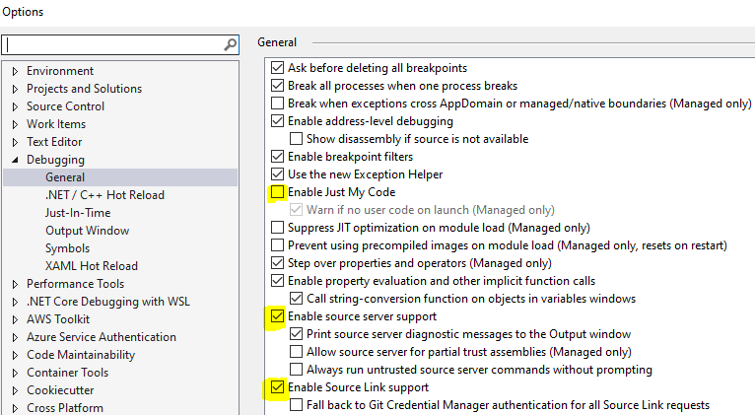
Source Link - Visual Studio
Notes:
This isn’t however enabled by default.
In visual studio open the options and make sure to check/uncheck the following boxes.
Spoiler if you are using gitlab, it will most likely not work. They partially implemented it but for some reason the icing on the cake is still missing.
OPEN THE CLIENT SOLUTION
Update the NuGet package to version 1.0.1 and set the options like the screenshot.
Spin up the web api client verify that we are on version 1.0.1
If so go to post call execute it to show the error is still there and set the breakpoint again at that location.
Execute the call again and press F11
The bug is revealed
Show the difference, package are located under NuGet -> src -> DigitalDiary.MemoryRepository -> bin -> Debug
The health indicates if there are missing pieces. If one of them is missing you will have not be able to debug it.
The repository is an interesting one as this one brings you to the specific version upon which the packages is based on. Click on the link and go then to branch release/1.0.1

Slide 9
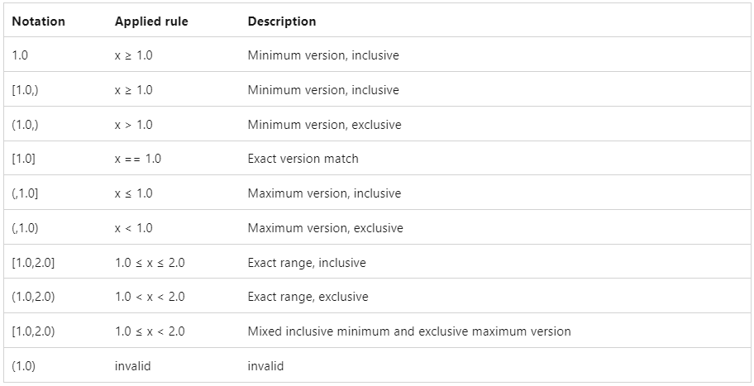
Package Versioning
Notes:
When I showed the initial configuration of the NuGet project I highlighted the floating version you could configure on your project.
This list shows the other possibilities you could use as well. I don’t know all of them by hard to be honest but it’s good to know that it can be done.
OPEN THE CLIENT SOLUTION
Because I’m lazy and I want the fix as soon as possible I will make my project use the floating version approach.
Double click on the csproj, set the float, rebuild and launch, go immediately for the POST option this time. The breakpoint is still there and use F10 to step over it, it should not fail this time.
Minimize the dotnet project.
The api returned success ☺
But hey what is that with the output suddenly.

Slide 10

You have been hacked
Notes:
But how?
I do hope you have a plan of action when you realize this has happened to you. You can’t just shove this under the carpet but how you deal with it that is something who is most likely different for each company.
Hopefully, you figure this out before your customers do.

Slide 11

Typosquatting
Original
Samyne.DigitalDiary.MemoryRepository
Examples
Samyne.DigitaIDiary.MemoryRepository
Samyn.DigitalDiary.MemoryRepository
Sarnyne.DigitalDiary.MemoryRepository
5amyne.DigitalDiary.MemoryRepository
Notes:
You could have been fallen victim of typo squatting. Annoying as it is, just make sure you used the correctly typed package.
I’ve added some possible candidates for my demo package as well to make the issue clearer. Some are obvious others not so much.

Slide 12

Dependency Chain Attack
Types
A trusted package is attacked
Confusion attack
Counter measures
Register your prefix on NuGet.org
Package signing
Package locks
Package Source Mapping
(Verify the used signing certificate)
Notes:
The previous one wasn’t our situation. We got victim of a dependency chain attack.
My trusted repository package was successfully attacked and somehow, I pulled it.
GO TO NuGet.org, https://www.NuGet.org/packages/Samyne.DigitalDiary.MemoryRepository/
The prefix is reserved and only 2 packages are deployed there, so the issue isn’t located here.
But since we are here you can manage your packages here as well
There are 2 important places here, with deprecation you can instruct users of your package to move to another version and with listing you can decide to hide the package from the overview if you list the packages. The latter means that a package could exist on NuGet.org but you simply can’t see it as this checkbox is being turned off. In our case this isn’t what happened.
What did happen then?
GO TO THE CLIENT Solution and open the NuGet.config
Here the evil has been revealed. The project has another repo configured as well, and because we’ve requested a floating version 1.* we’ve pulled in a bigger version number.
Right click to manage the NuGet packages and reveal the existence of the package 1.5.0
If time permits, show how I pulled it off but that is not the goal of this session though.
GO back to the slides
Luckily, there are counter measures available.
Although this session attacked my private repo, make sure that you’ve also registered the prefix of your own custom packages on NuGet.org. You don’t have to put any packages online. But you’ve successfully stopped others from abusing your prefix as well.
Sign the packages with a certificate, if you put them on NuGet.org it’s done by default with one of Microsoft their certificates, you can always opt for using one of your own certificates as well. Once they are signed the packages are accompanied with a hash which is verified in visual studio but maybe also in other IDE’s and the package will be rejected if tampered. After all this is just a zip file and you can always add, remove, update files in it. But if it is signed you messed up the hash. So for your private NuGet repo it’s better to sign them as well.
Configure your project to use locking, this ensures that everyone is using the same NuGet package as a source. Either you are all hacked or just 1 device has been tampered. This will help you reveal it.
Configure Source Mapping, this will ensure that even when an evil package is on the private repo. It will ignore that one and use the public repo. You could play with this as it is the most restrictive package name who wins.
You could go a step further and ensure that a package with source mapping should have been signed with a specific certificate. Although safer, I found this one personally an annoying step and accepted that fact if someone was able to breach my account, they could publish a package on my behalf using a public certificate.

Slide 13

Tighten your NuGet packages
Notes:
Before we start operating our solution make sure you cleaned the caches of all the systems who worked with that impacted solution. You can’t know by heart if they were out after your production environment, or your internal environment.
OPEN UP THE CLIENT
For registering the prefix on NuGet.org I can’t provide an example, you just need to go through the registration process.
Signing the package is done when the package has been created, this should be a concern of your pipeline. If you post to NuGet.org they are doing this for you, for a local environment you should configure this yourselves. But it isn't rocket science.
Rolling back to the untampered version should be the priority. (1.0.1)
In the root Directory.Build.Props we set the following properties:
<PropertyGroup>
<RuntimeIdentifiers>linux-x64;linux-arm64;</RuntimeIdentifiers>
<RestorePackagesWithLockFile>true</RestorePackagesWithLockFile>
<RestoreLockedMode Condition="'$(CI_SERVER)' == 'yes'">true</RestoreLockedMode>
</PropertyGroup>
Let’s explain, runtime identifiers are important to indicate for which runtime you are targeting your build. In this example the result will eventually be build on a linux x64 or arm so the lock file must take this into account.
RestorePackagesWithLockFile is the element who triggers the creation of the packages.lock.json files which are now added through the entire solution. When this option is turned off however and the files aren’t removed, they will still be honored.
RestoreLockedMode instructs the it may only restore the package which are configured in the lock file without making updates to your lock file. This is also why this element is only active on the pipeline but not on your local dev. If it is it will be a nightmare to work with it.
If you double, click on a packages.lock.json you will then see the logic it uses for restoring a NuGet packages ensuring that restores are done on all systems the same way. Remember the slide where I showed all the possibilities you could use for configuring the allowed versions? Well, here they are actively used.
Suppose we take the current attack vector in mind. If would become rapidly clear something is off when you also have version 1.5.0 on NuGet.org in those case, you will have a roulette situation and the first responder will win so sometimes NuGet.org will provide sometimes the local one. Although if it comes immediately from you disk NuGet.org will rarely win.
Ok let’s close the gap a bit more and configure package source mapping.
It’s easier to change temporarily the folder where your solutions is obtaining its packages.
UNCOMMENT THE GLOBAL_PACKAGES_FOLDER IN THE NUGET.CONFIG and restart the solution.
If we look at the globalPackagesFolder we see that it restored all packages it needs for building the current project. In real non demo projects this could be a long list. It is interesting to verify how certain packages are added to your solution. As you can see this list doesn’t hold any indications if they are coming from NuGet.org or the private repo.
If you’ve never done this before you could opt for figuring everything out manually. But I recommend of using a more automated approach and then go over the result and apply them.
There is a tool created NuGet.PackageSourceMapper which can be added to your local dotnet cli by running the following command:
dotnet tool install -g NuGet.PackageSourceMapper -v
Only make sure you do this in a folder which is currently not under the influence of an already existing package source mapping as it could refuse to install it as most likely this package will not be known.
MAKE SURE YOU ARE IN THE ROOT OF YOUR CLIENT WITH POWERSHELL AND EXECUTE THE NEXT COMMAND
packagesourcemapper generate nuget.config
After this ran it will give you a summary on where it found packages you are currently using. And it stored it in the file nugetPackageSourceMapping.config when we open it up, we don’t see our local repo appearing in it which was expected.
Interesting to highlight here is the usage of the * with the Microsoft packages. It means that it will try to retrieve all packages which start with microsoft. from this package source but if we would add Microsoft.test,* in our private repo it would then go for those to the private repo, the most restrictive one will deliver the package.
In this case I’m ok with the proposed changes.
Copy/Paste the content into your nuget.config and disable the globalPackagesFolder again and rebuild. Best to restart the solution again now so the change are applied properly. Visual studio sometimes doesn’t pick these things always up immediately.
Ok let's verify if we apply the floating version again if we still are open to this attack.
Set the floating version again in the Directory.Build.props and rebuild. As you see we don’t get the 1.5.0 version anymore, also running the force will not update it. As that version is ignored.
One final test, lets try to update the NuGet package to the evil version 1.5.0 via Manage Packages for solution.
It worked :s, the reason why it worked is because I didn’t clear my local cache and then it doesn’t download it. I deliberately didn’t do it for this demo to demonstrate once a bad package is pulled it is important to clear the cache. If we enable the globalPackagesFolder now again, you’ll see it will not work. In the errors you will see a clear description of what is wrong.
These floating versions are a fun thing to use but if you have the luxury of using an automated dependency update tool. These could give you issues.
We are using renovate maybe others exists as well and it will ignore floating versions and if you have NuGet packages configured in a Directory.Build.props you will face broken merge requests in combination with the package.locks.json
In that case the only solution is using the new Central Package Management for your NuGet packages.
To activate CPM, it must be enabled at your root level in the Directory.Build.props by adding the
<ManagePackageVersionsCentrally>true</ManagePackageVersionsCentrally>
Next to this we need to create a file called Directory.Packages.props and configure all the direct referenced packages from your solution. In this case it’s only a few packages again in a large project this could be a lot of work. But it’s worth the effort.
Just copy over the package references form your solution and paste them in this file and rename the element to PackageVersion in the project remove the version value as this is now dictated by the Directory.Packages.props.

Slide 14

Conclusion
Notes:
This session took me about a year and a half to fill in all the pieces. As a lot of knowlededge was missing on my end. Although freely available on microsoft learn.
I hope I got your attention on the hack part as if you use it out of the box you are vulnerable.
Not all parts are maybe applicable to your needs I refer then especially to the floating versions and CPM with an automated dependency update tool. It is a great time saver if you do. Especially with the lock files being introduced an automated dependency tool is not a luxury since you will face merge conflicts quite often otherwise on your solutions unless you don’t keep your solutions up to date. But then you will face cosolidation issues eventually and a lot of other oddities could then start to rise up as well.

Slide 15
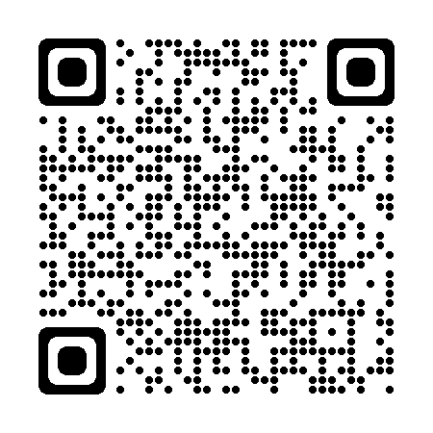
Appendix
Directory.Build.targets, Directory.Build.props https://learn.microsoft.com/en-us/visualstudio/msbuild/customize-by-directory?view=vs-2022
Licensing https://learn.microsoft.com/en-us/NuGet/reference/nuspec#license
Source Link https://learn.microsoft.com/en-us/dotnet/standard/library-guidance/sourcelink
Package versioning https://learn.microsoft.com/en-us/NuGet/concepts/package-versioning
Best practices for a secure software supply chain https://learn.microsoft.com/en-us/NuGet/concepts/security-best-practices
Package source mapping https://devblogs.microsoft.com/NuGet/quickly-map-your-NuGet-packages-to-sources
Building a supply chain attack with .NET, NuGet, DNS, source generators, and more! https://blog.maartenballiauw.be/post/2021/05/05/building-a-supply-chain-attack-with-dotnet-NuGet-dns-source-generators-and-more.html
Code used in this session https://github.com/PhbsSmn/TightenYourNuGetPackages.NuGet https://github.com/PhbsSmn/TightenYourNuGetPackages.Client
Notes:
These are some addtional interesting links about this topic which helped me during my research.
If there are any questions feel free to ask them now or afterwards or via linkedin.

